Slide 1

Library Management System in C++

Slide 2
Team Members
1
Jivan Jyoti Jala
2
Mayank kumar
CL2025010601910339
CL2025010601926091
3
Riya Metha
4
Rishi Kumar Sah
CL2025010601889072
CL2025010601937680
5
Debadutta Sahoo
CL20250106019055113

Slide 3
Content
1
Introduction
2
implementation Details
3
Key/Features
4
Functionality
5
system Architecture
6
Solution & Challenges
7
Future Enhancement
8
Conclusion

Slide 4
Introduction
This project outlines a C++ Library Management System (LMS). The goal is to create a robust, efficient, and user-friendly system. It will help manage library resources for librarians, staff, and members. We will use C++ with standard libraries for development.

Slide 5
Key Features of the LMS
1
Book Management
2
User Management
Add Book,Display Books ,Search Books,Delete Books
Register Users,Display Users,Delete Users
3
Borrowing and Returning Books
4
Borrowing History
Borrow Books – Allows users to borrow books if they are available. Updates the stock count.
User Borrow History – Displays which books a user has borrowed.
Return Books – Users can return borrowed books, increasing the stock count.
5
Data Persistence
6
Reporting
Load from File – Reads book and user data from library.txt and users.txt
Generate Report – Provides an overview of books and users in the system
Save to File – Saves updated book and user information back to files after changes.

Slide 6




System Architecture
User Interface
🔹 Menu-based Console Interface
Users interact via a simple number-based menu.
Application Layer
🔹 Manages core operations like book borrowing, returning, and reporting.
Processes user requests & updates data accordingly.
Data Layer
🔹 Handles reading/writing user and book data from files.
Uses text files (library.txt & users.txt) for persistent storage.
The system uses modular design for maintainability and scalability. Current data storage is file-based with C++ file I/O.

Slide 7
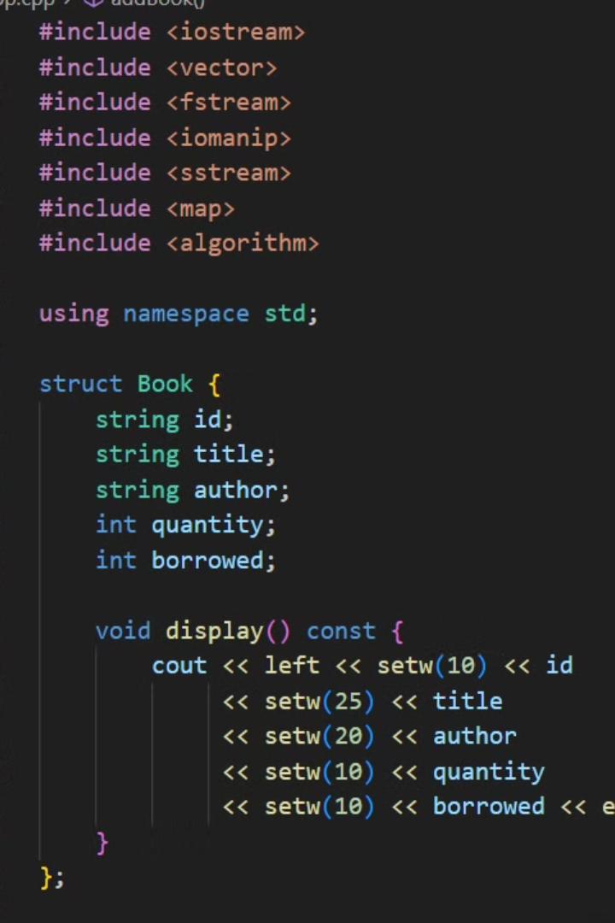
Implementation Details
📚 Book Structure
User Structure
Attributes: ID, title, author, quantity, borrowed count.
Attributes: User ID, name, borrowed books list.
Stored in: library.txt (persistent file storage).
Stored in: users.txt (persistent file storage)
Data Storage & Structures
Data Structures Used:
std::vector → Stores list of books and users in memory.
std::map → Maps book IDs to books for quick lookup.
std::list → Manages borrowed books per user.

Slide 8
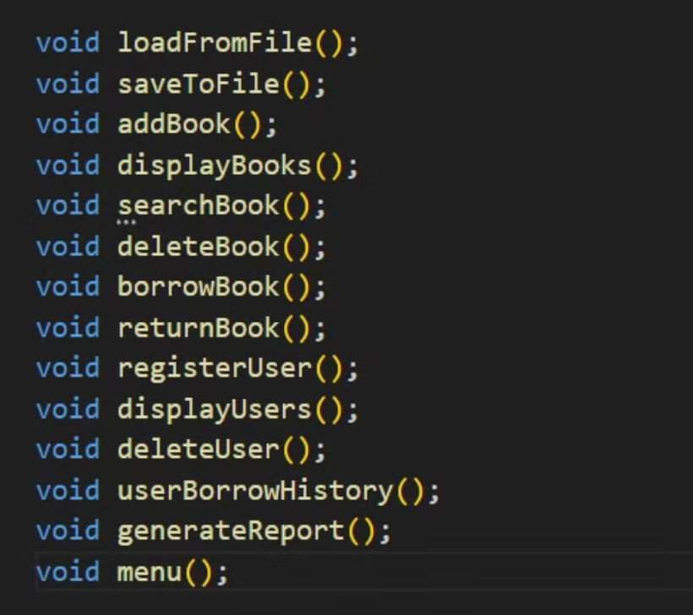
Function

Slide 9

Challenges and Solutions
1
Data Persistence
Robust file I/O, error handling.
2
Efficient Search & Retrieval
Optimized search using maps.
3
User Management
Borrowing limits, duplicate check.
4
Error Handling
Input validation, try-catch blocks.
We will use exception handling using `try-catch` blocks. Optimize data structures and algorithms, and consider using a database.

Slide 10




Future Enhancements
GUI
1
Database
2
4
More Features
3
Online Access
Develop a GUI using a C++ GUI framework, such as Qt. Also, migrate to a database system like MySQL.

Slide 11

Conclusion
1
Achievements
2
Lessons Learned
3
Future
Functional system.
Modular design is important.
Continued development.
Key achievements include a functional and efficient system. We learned the importance of error handling and thorough testing.

